Slide 1

Coachella Valley Water District
Water Service and Water Meter Sizing Criteria Workshop
April 13th from 10:30-11:30am
April 19th from 1:30-2:30pm
CVWD
Engineering
Domestic Water Engineering
Development Services
Notes:
Title Page - Dates and Times of workshop

Slide 2
Agenda
Introduction
Background
CVWD Domestic Water System
Guidelines for Water Service and Meter Sizing Design by the EOR
Examples
Revised Meter Application Process
Questions
Notes:
Agenda Page

Slide 3

Background
2010 California Residential Code
The California Building Standards Commission approved and adopted the 2010 California Residential Code (California Code of Regulations, Title-24, Part 2.5) based on the 2009 edition of the International Residential Code (published by the International Coe Council) with an effective date of January 1, 2011. The provisions of Sections R313.1 (Townhouse) and R313.2 (One- and two-family dwellings) reads: “An automatic residential fire sprinkler system shall be installed in townhouses and in one- and two-family dwellings” respectively.
Additional Information
NFPA 13D
AWWA M6
CVWD – Development Design Manual
Notes:
Code

Slide 4
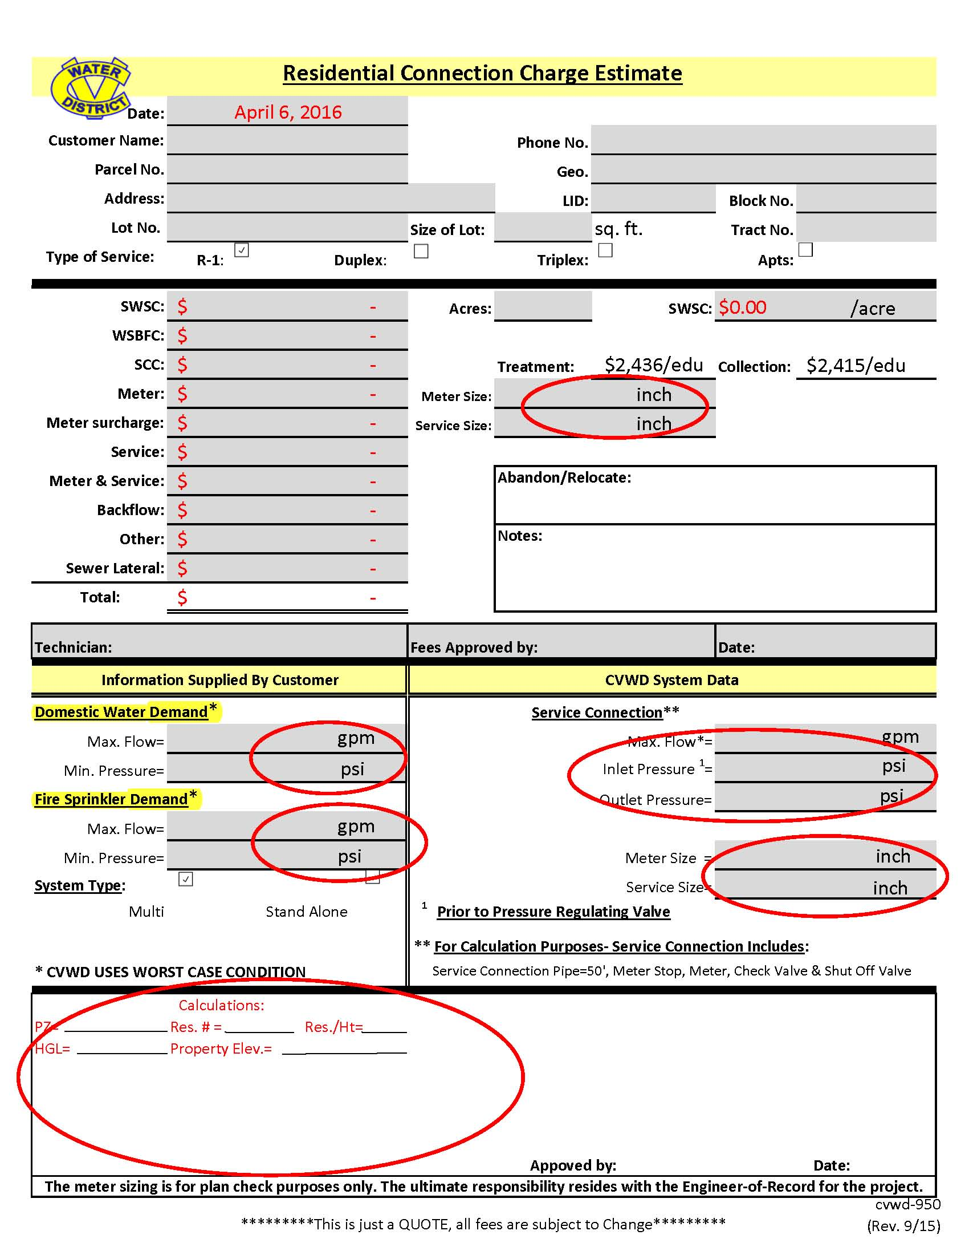
Current Process
Water Plans Designed (No calculation on service size)
Project is Constructed
Request for Service
Engineer, Developer or Customer provides Domestic Water Demands (Max Flow/Min. Pressure)
Service under sized for requested flow/min pressure
NEXT
Tract No.
Dwg No. XXXXXX
1” Service W/3/4” Meter
Agreement
Notes:
Current process for sizing service needs to be done with the design of domestic water plans

Slide 5
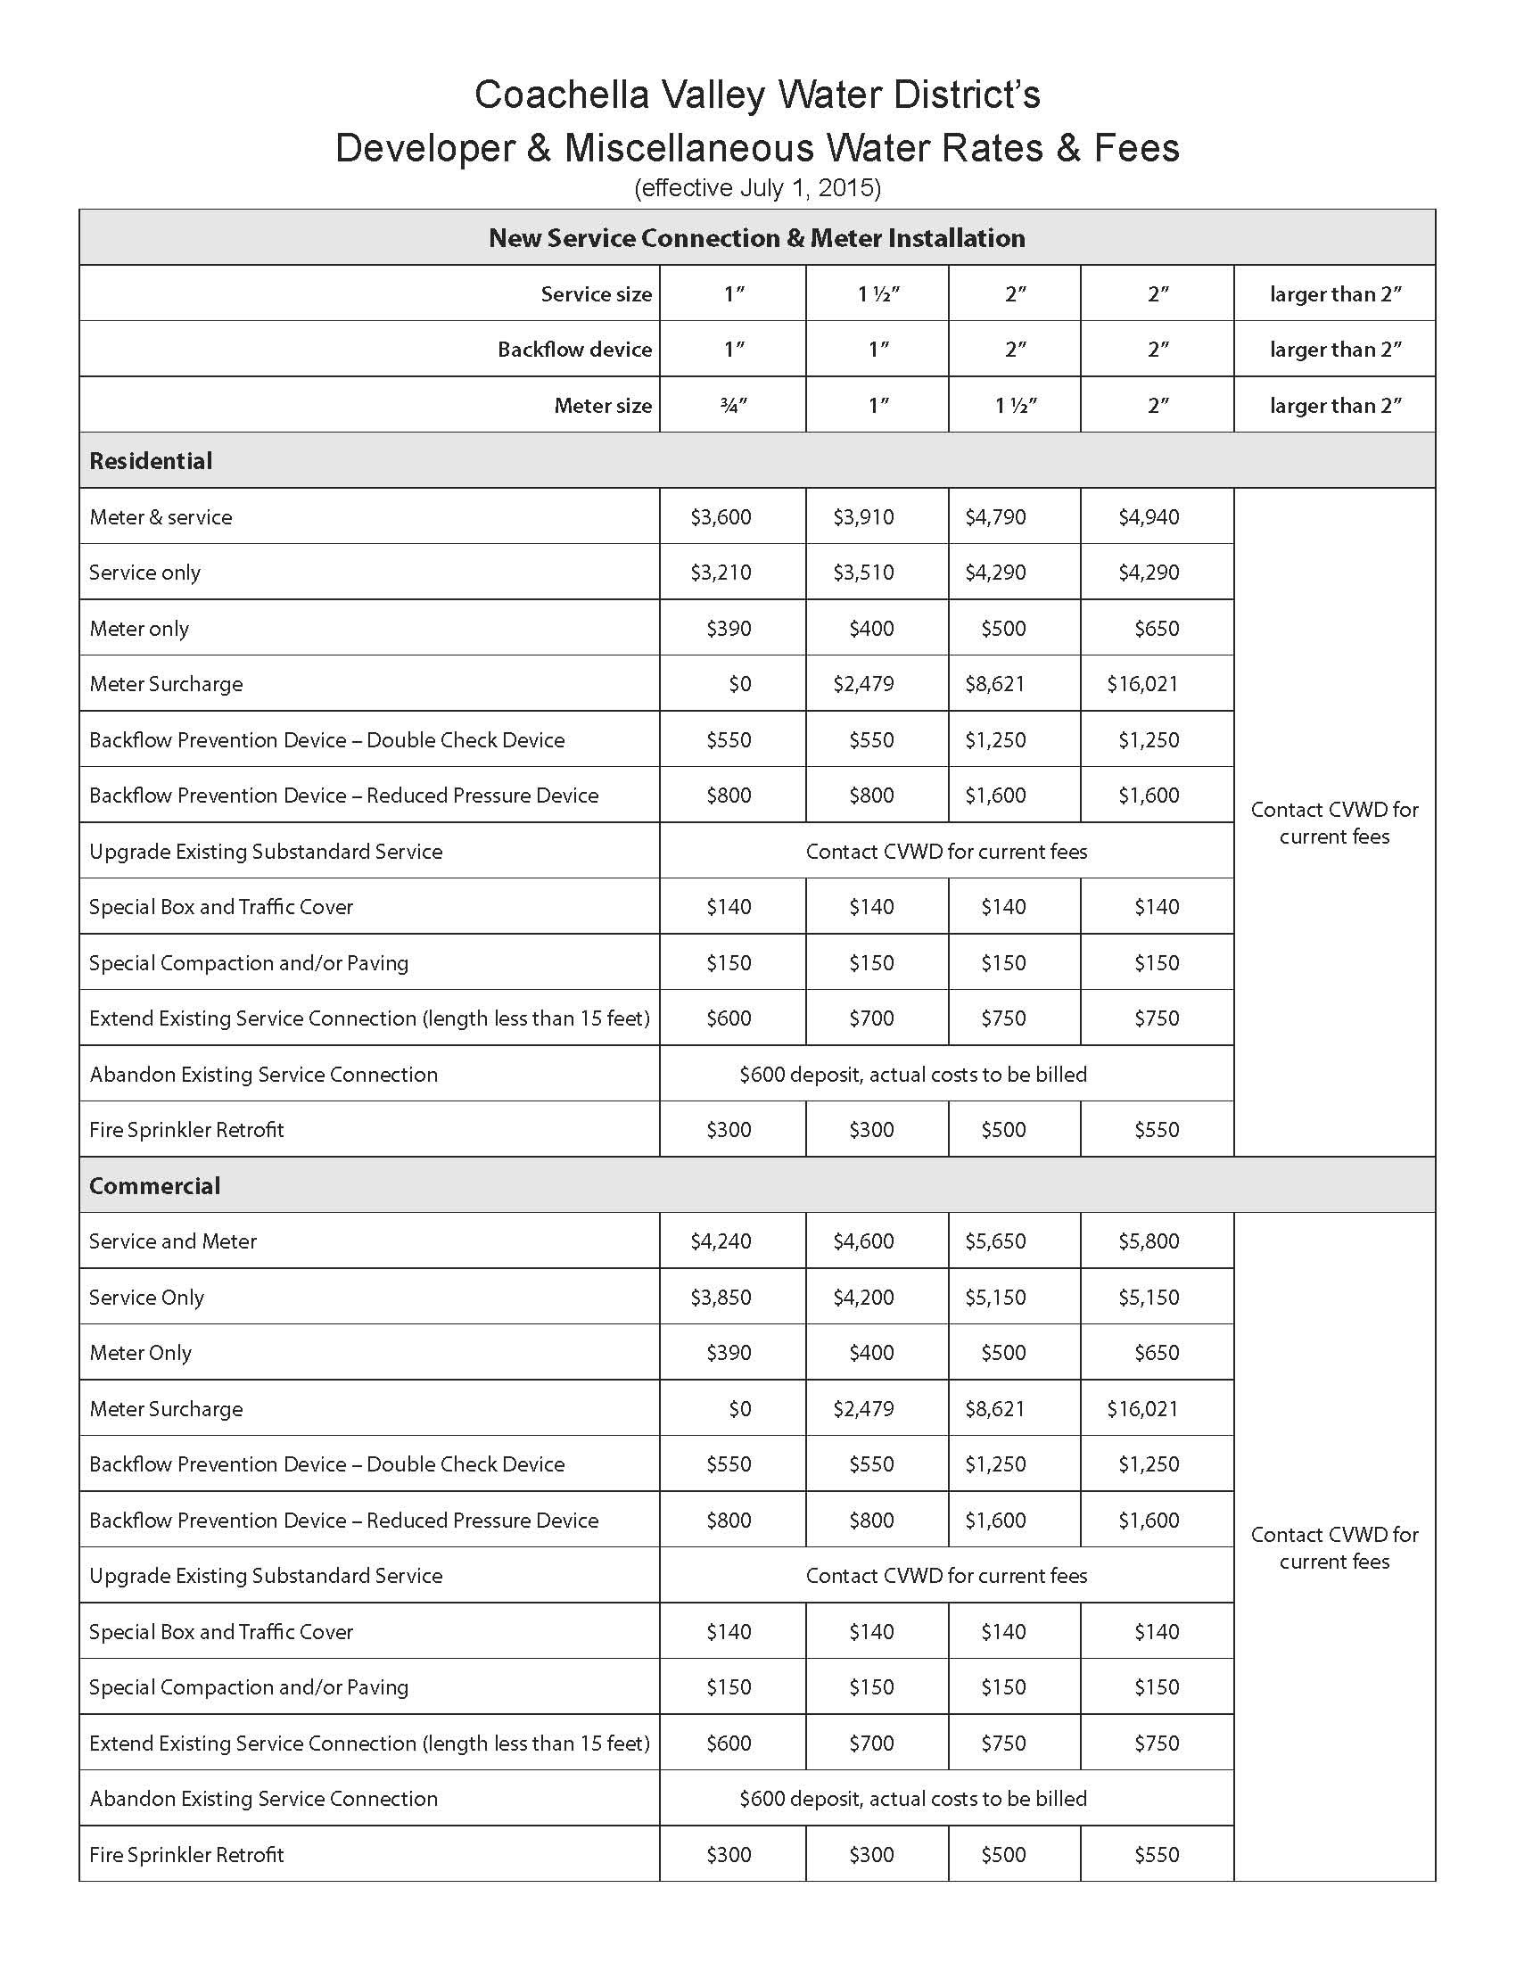
Permanent Service Connection Installation Charges
Upsizing Service Costs Example
From the water plans ¾”M/1”S to a 1”M/1 ½“S
Abandon Existing service = $600⁺
Install new 1 ½“ Service Line = $3,510
1” Meter = $400
Meter Surcharge = $2,479
Total = $6,989⁺
Additional Impacts
Delay in receiving Domestic Water Service
Must schedule CVWD to remove existing service and install new service line and meter
Requires pavement to be cut and patched
E
Notes:
Costs involved by not designing service size during the design of water improvement plans
Upsizing Service Costs Example
From the water plans ¾”M/1”S to a 1”M/1 ½“S
Abandon Existing service = $600+
Install new 1 ½“ Service Line = $3,510
1” Meter = $400
Meter Surcharge = $2,479
Total = $6,989+
Addition Impacts
Delay in receiving Domestic Water Service
Must schedule CVWD to remove existing service and install new service line and meter
Requires pavement to be cut and patched

Slide 6
Benefits of New Process for Water Service and Water Meter Sizing
Reduces inaccuracy of meter and service line sizing
Speeds up processing of Residential Connection Charge Estimate
Reduces time to review meter installation requests (check plans for meter size, demands and minimum pressure)
Avoids multiple resubmittals (2 to 3 weeks+)
Avoids costly upsizing of service line size
Avoids delays to schedule the removal and upsizing of the existing service line
Avoids cutting new street pavement

Slide 7
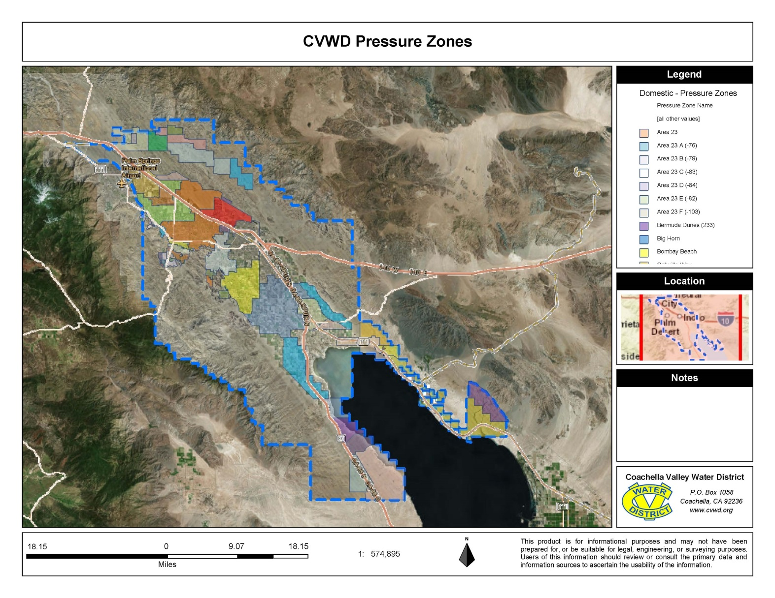
CVWD Domestic Water System Pressure Zones
69+ Pressure Zones
E
Notes:
CVWD’s Domestic Water System is made up 69+ Pressure Zones and Sub-zones
CVWD Staff will help you identify which pressure zone your project is in

Slide 8
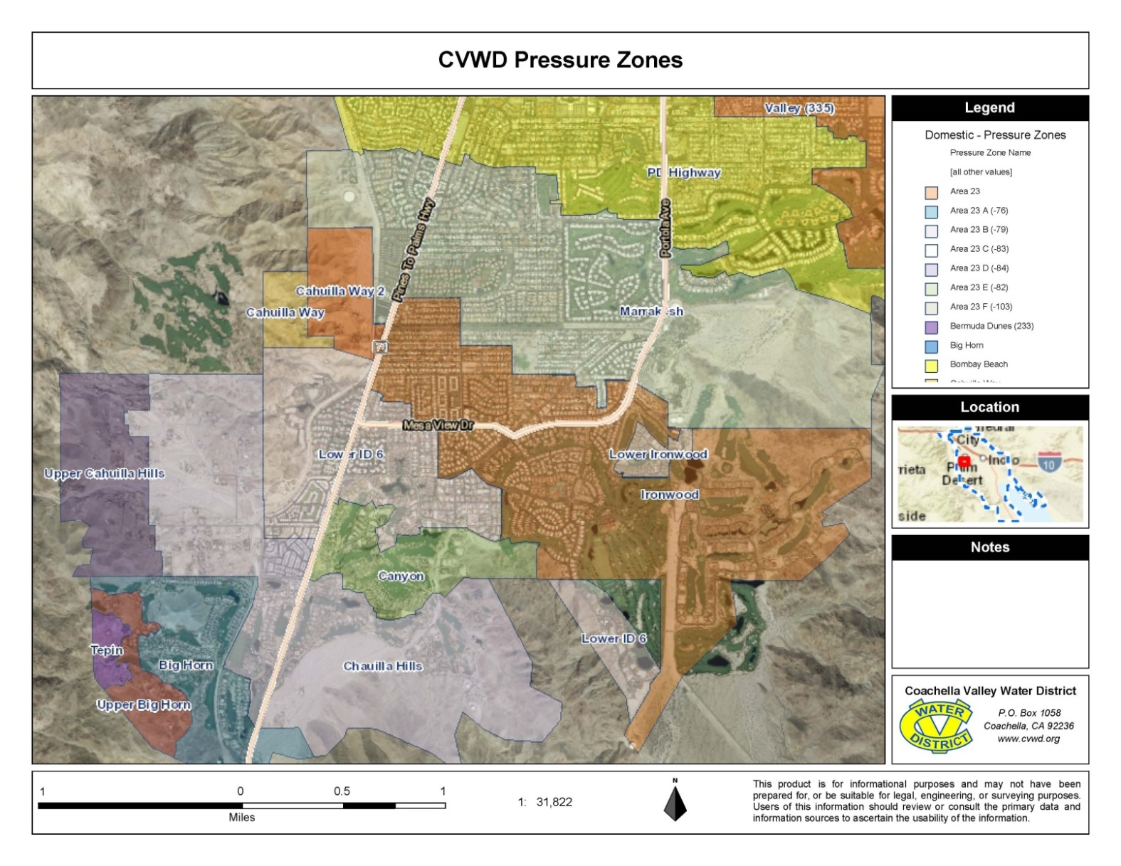
CVWD Domestic Water System Sub-Pressure Zones
Notes:
Sub Pressure Zones
Some of the sub-zones are hydropneumatic pressure zones and which are a special case for calculating the service size. You will need to contact CVWD on these.

Slide 9
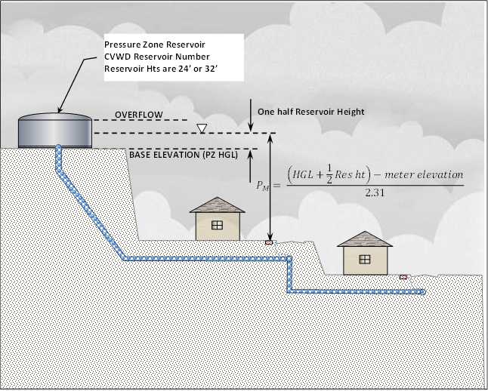
Static Pressure
Pressure Zone hydraulic grade line (HGL)
The location of a reservoir is dictated by the hydraulic grade line (feet above MSL) of the pressure zone when the reservoir is empty (base elevation). CVWD requires a minimum static pressure of 60 psi at all points within the development based on the elevation of the reservoir. Reservoir heights are generally 24 or 32 feet.
Notes:
For static pressure CVWD adds ½ the reservoir height to the reservoir base elevation which is the pressure zone HGL

Slide 10
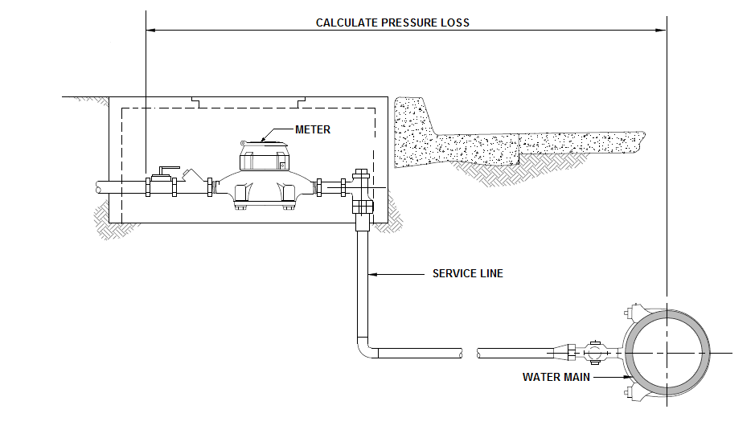
Calculate Pressure Loss
Corporation Stop
Copper (Type K) Service Line
Service Line Fittings
Angle Meter Stop
Water Meter
Straight Check Valve
Shut-off valve
Also See
AWWA M6 Table 3-3
DDM
CVWD’s approved material list
Manufacture Specification Sheet
CVWD Standard Drawings
W-7 Detail of 1” Service Connection and Meter Installation
W-9 Detail of 1 ½” Service Connection and Meter Installation
W-11 Detail of 2” Service Connection and Meter Installation
E
Notes:
This slide shows what is to be considered in the EOR pressure loss calculations

Slide 11

Water Service And Water Meter Sizing Criteria
CVWD Pressure Zone __________ (A) See Pressure Zone Table____________ (HGL) ______(C) See Pressure Zone Table_______
The Engineer of Record (EOR) is responsible for calculating and designing the required service line and meter size based on the critical pressure and fire sprinkler and/or domestic water demands needed at each lot. The above table must be placed on the Domestic Water Plans for first plan check.
Guidelines for calculating the water service line and meter size are:
Determine the CVWD pressure zone for the meter and HGL based on half full reservoir (See CVWD Pressure Zone Table)
Determine the elevation at each meter location in Average Mean Sea Level (AMSL)
$$P_{M}= \frac{\left(HGL+\frac{1}{2}Res ht\right)−meter elevation}{2.31}$$
Calculate the static pressure (P_{M})
Domestic Water Service Meter and Service Run Table
Lot No. | PZ (HGL) + ½ Res Ht (E) | Meter Elev. | Static Pressure at meter (psi) | Fire Sprinkler Demand/Pressure (gpm_{max}/psi_{min}) | Domestic Water Demand/Pressure (gpm_{max}/psi_{min}) | Service Run Length (ft) | Customer Side of Meter Pressure | Service Run Size (inches) | DW Service Meter Size
 |  |  |  | / | /
 |  |  |  | / | /
 |  |  |  | / | /
Notes:
CVWD Residential Fire Sprinkler Guide with required table

Slide 12
Determine the service run length from the domestic water main to the meter
Determine worst case condition of the Fire Sprinkler or Domestic Water demand and pressure
The EOR must determine the total head loss (in psi) at the required critical gpm flow rate. Losses typically include the following:
Meter – Head loss based on the proposed meter
Service line – Head loss based on the proposed service line size
Fittings – Head losses from all fittings and valves to the customer side of the meter
Head losses from backflow devices or other appurtenances
Subtract all head losses from the static pressure to determine the available pressure on the customer’s side of the meter. If the available pressure or flow on the customer’s side of the meter is less than the worst case required pressure and/or flow, repeat the calculations using the next larger meter/service line combination size. Repeat process until the required pressure and flow criteria is satisfied.
Also refer to the California Residential Code, Title 24, Part 2.5, R313 and NFPA - 13D, for additional information regarding the sizing of service lines.
Notes:
CVWD Residential Fire Sprinkler Guide with required table

Slide 13
Additional Information
Typical service/meter combinations are as follows, although other combinations may be approved subject to CVWD’s discretion. However, meter sizes cannot exceed the service line size.
Type K Copper information:
Typical fittings that are included in the head loss calculations include corporation stops, angle meter stops, ball valves, and check valves. See the manufacturer’s data sheets for head loss factors. Refer to CVWD’s “Approved List of Materials” for approved products. This information may be found at our website at http://www.cvwd.org/208/Development-Design-Manual .
CVWD currently uses the following meters. See the manufacturer’s head loss curve tables to determine the head loss through the meter at the required flow rate:
Master Meter – 3/4” Multi-Jet Meters (max. 30 gpm)
Master Meter - 1” Multi-Jet Meters (max. 50 gpm)
Master Meter – 1 1/2” Multi-Jet Meters (max. 100 gpm)
Master Meter - 2” Multi-Jet Meters (max. 160 gpm)
1" service | 3/4" meter
1.5" service | 1" meter
2" service | 1.5" meter
2" service | 2" meter
Size | C_{HW} | I.D.
5/8" | 130 | 0.652
3/4" | 130 | 0.745
1" | 130 | 0.995
1 1/2" | 130 | 1.481
2" | 130 | 1.959
E
Notes:
CVWD Residential Fire Sprinkler Guide Additional Information

Slide 14
CVWD Pressure Zone Table
CVWD Pressure Zone Table
(A) | (B) | (C) | (D) | (E)
Pressure Zone | Res No. | Elev. (HGL) | Ht (ft) | Elev + 1/2 ht
Area 23 | 7101 | 13 | 32 | 29
Bighorn | 6502 | 1140 | 20 | 1150
Cahuilla Hills | 5501 | 1040 | 21 | 1050.5
Cahuilla Hills | 6501 | 1040 | 20 | 1050
Canyon | 6603 | 940 | 32 | 956
Date Palm | 3571-1 | 565 | 32 | 581
ID 13 | 8111 | 13 | 32 | 29
ID 15 | 8121 | 13 | 24 | 25
ID11 | 1092-2 | 47 | 24 | 59
ID 6 | 5503 | 840 | 21 | 850.5
ID 6 | 6602 | 840 | 20 | 850
Indio Hills | 4711-1 | 1335 | 16 | 1343
Ironwood | 5648 | 684 | 32 | 700
Ironwood | 6615 | 684 | 32 | 700
Lake Cahuilla | 6725 | 145.5 | 32 | 161.5
Lake Cahuilla | 6726 | 145.5 | 32 | 161.5
Lower ID 8 | 3501-1 | 1040 | 24 | 1052
Lower Indio Hills | 4701 | 1145 | 11 | 1150.5
Lower La Quinta | 6630-1 | 235 | 32 | 251
Lower La Quinta | 6630-2 | 235 | 32 | 251
Lower Thousand Palms | 4602 | 335 | 24 | 347
Lower Thunderbird | 5514 | 492 | 32 | 508
Marrakesh | 5643-1 | 545 | 24 | 557
Marrakesh | 5643-2 | 545 | 24 | 557
Mecca | 6806 | -148 | 24 | -136
CVWD Pressure Zone Table Continued
Mecca | 7993 | -186 | 24 | -174
MHPZ | MHPZ | 500 | 32 | 516
Middle La Quinta | 6631-1 | 350 | 32 | 366
Middle La Quinta | 6631-2 | 350 | 32 | 366
Middleton Road | 7802 | 60 | 24 | 72
Mirada | 5505 | 825 | 32 | 841
North Shore (152N) | 7102 | 120 | 32 | 136
North Shore (152S) | 7103 | 120 | 32 | 136
Palm Desert Highway | 5617-1 | 400 | 24 | 412
Palm Desert Highway | 5617-2 | 400 | 24 | 412
Palm Desert Highway | 5644 | 400 | 24 | 412
Quarry Ranch | 6730 | 8 | 24 | 20
Rancho Mirage | 5510-1 | 443 | 24 | 455
Rancho Mirage | 5510-2 | 443 | 24 | 455
Sky Mtn | 4603 | 435 | 32 | 451
Sky Mtn | 5504-1 | 435 | 32 | 451
Sky Mtn | 5504-2 | 435 | 32 | 451
Sun City | 4730 | 290 | 32 | 306
Upper Bighorn | 6503 | 1240 | 24 | 1252
Upper ID 8 | 3601 | 1425 | 30 | 1440
Upper La Quinta | 6632-1 | 482 | 24 | 494
Upper La Quinta | 6632-2 | 482 | 24 | 494
Valley | 5509-1 | 335 | 24 | 347
Valley | 5509-2 | 335 | 24 | 347
Valley | 5513 | 335 | 24 | 347
Valley | 5655 | 335 | 24 | 347
Valley | 5690 | 335 | 24 | 347
Wide Canyon (1616) | 3602 | 1616 | 24 | 1628
E
Notes:
Pressure Zones and Reservoir Table

Slide 15
Example 1
Required Information
Determine CVWD Pressure Zone
Reservoir elevation and height of reservoir
Meter elevation
Service run length
Worst Case condition of Fire Sprinkler or Domestic Water Demand
Calculate Pressure Loss from water main to customer side of meter
Notes:
Example 1
What is needed to calculate the meter and service line size
Required Information
Determine CVWD Pressure Zone
Reservoir elevation and height of reservoir
Meter elevation
Service run length
Worst Case condition of Fire Sprinkler or Domestic Water Demand
Calculate Pressure Loss from water main to customer side of meter

Slide 16

Example 1
$P_{M}= \frac{\left(HGL+\frac{1}{2}Res ht\right)−meter elevation}{2.31}$
P_{M} = 74.7 psi
P_{LF} = -6.8 psi
P_{LP} = -15.3
¾” Meter = -14.5 psi
P_{C} = P_{M} – (P_{LF} + P_{LP} + M)
P_{C} = 38.1 psi for ¾”M/1”S
P_{LF} = -6.1 psi
P_{LP} = -2.2 psi
1” Meter = -4 psi
P_{C} = P_{M} – (P_{LF} + P_{LP} + M)
P_{C} = 62.4 psi
Pressure Zone
Reservoir
Meter Elev.
Fire Sprinkler
Domestic
Service Length
Try ¾”M/1”S
Try 1”M/1 ½”S
Middleton
Res7802
-100.50
30 gpm/60 psi
25 gpm/45 psi
50 Lin Ft
What would it take to stay with a ¾”M/1”S
Demand | Pressure
30 gpm
38 psi
29 gpm
40 psi
28 gpm
42 psi
27 gpm
44 psi
26 gpm
46 psi
25 gpm
48 psi
24 gpm
49 psi
23 gpm
51 psi
Domestic Water Service Meter and Service Run Table
Lot No. | PZ (HGL) + ½ Res Ht (E) | Meter Elev. | Static Pressure at meter (psi) | Fire Sprinkler Demand/Pressure (gpm_{max}/psi_{min}) | Domestic Water Demand/Pressure (gpm_{max}/psi_{min}) | Service Run Length (ft) | Customer Side of Meter Pressure | Service Run Size (inches) | DW Service Meter Size
1
72
-100.50
74.7
30 gpm/60 psi
25 gpm/45 psi
50
62.4
1 1/2
1
2 - 7
72
97 to 98.7
30 gpm/60 psi
25 gpm/45 psi
50
60.4 min
1
¾
-152 to -156
See DDM – Section 5.3 Pressure Zones and 5.18 Customer Pressure Reducing Valves (Uniform Plumbing Code, Section 608)
Below 60 psi requires a “Low Pressure Agreement” and if over 80 psi an individual PRV is required.
Notes:
Example 1
Walk thru process
Pressure Zone Middleton
Reservoir Res7802
Meter Elev. -100.50
Fire Sprinkler 30 gpm/60 psi
Domestic 25 gpm/45 psi
Service Length 50 Lin Ft
Try ¾”M/1”S
Perform pressure loss calculations for the fittings, copper pipe (remember nominal pipe diameter for type K copper) and meter
Result for the ¾”M/1”S
Pc=38.1 psi >>> Which doesn’t meet our need 60 psi
Try 1”M/1 ½“S
Result for 1”M/1 ½”S
PC = 62.4 psi >>> Meets pressure criteria of 60 psi
So what information goes in the table ?
What would it take to stay with a ¾ M/1”S
Special cases CVWD may allow a 1”M/1”S (see Development Service)
See DDM – Section 5.3 Pressure Zones and 5.18 Customer Pressure Reducing Valves
Below 60 psi requires a “Low Pressure Agreement” and if over 80 psi an individual PRV is required.

Slide 17
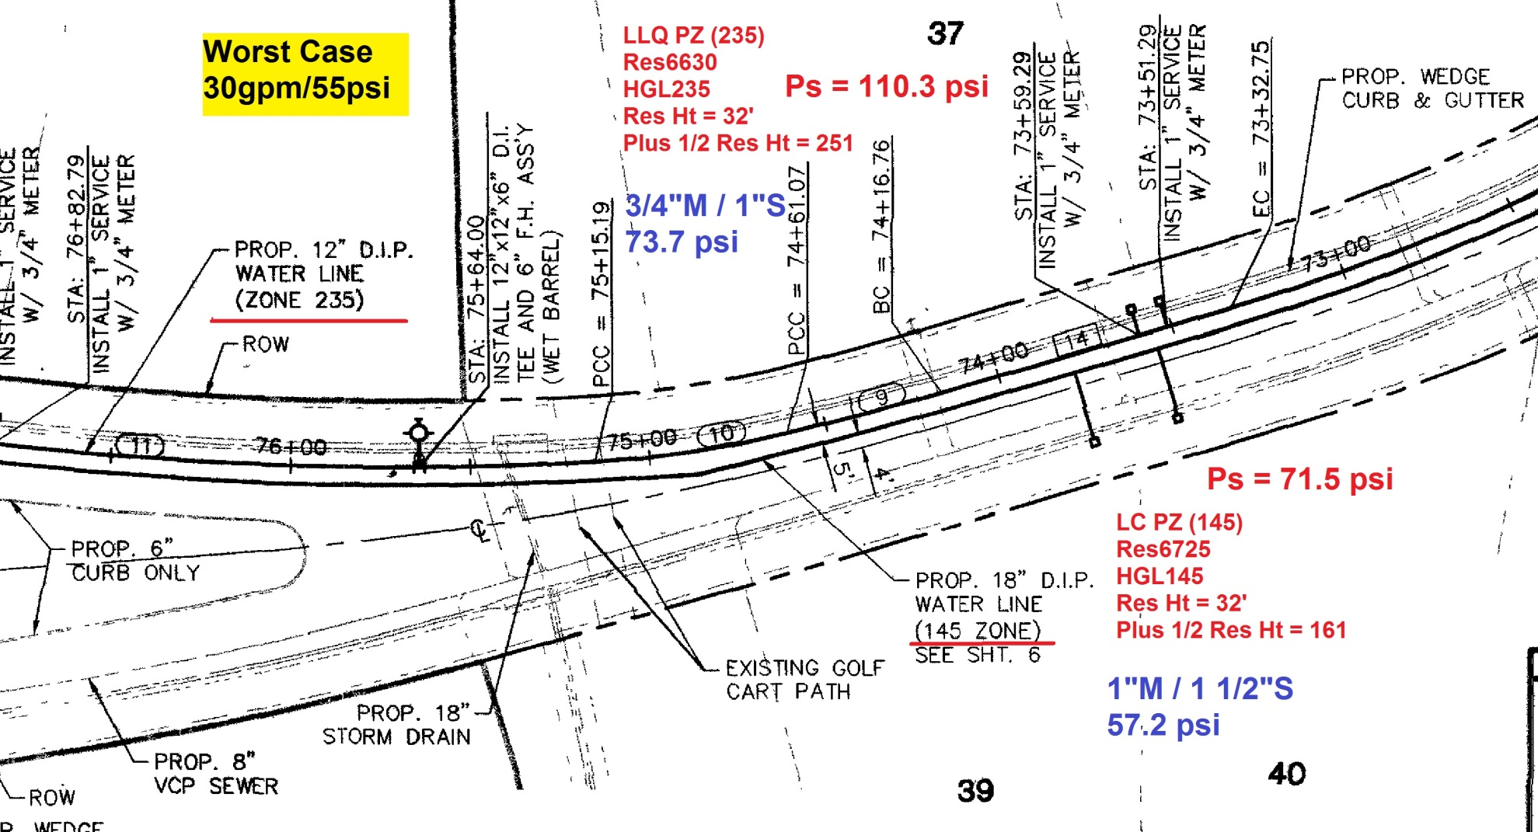
Example 2
Notes:
Example 2
This example has a Pressure Zone split (38.8 psi difference). There is 90 feet difference between the Lower La Quinta Pressure Zone (HGL 235) and Lake Cahuilla Pressure Zone (HGL 145.5)

Slide 18
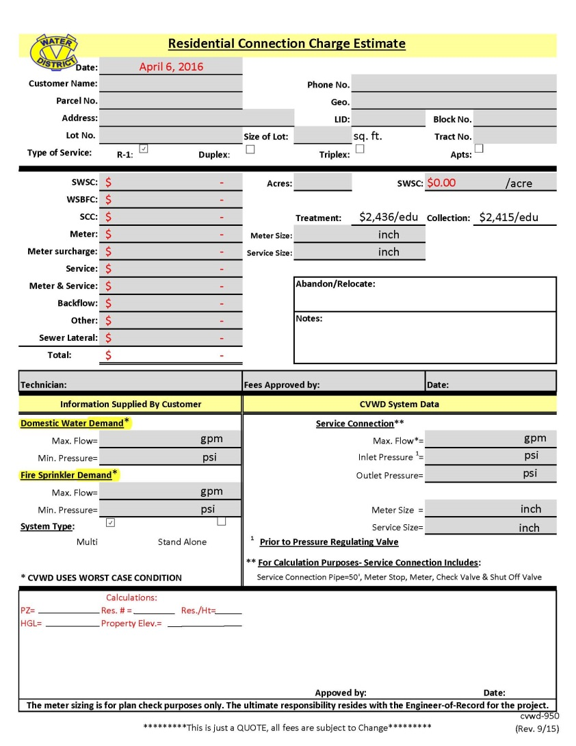
Revised Meter Application Process
CVWD will help determine the Pressure Zone that the project is in
First Plan Check of Water Improvement Plans
Include a completed Domestic Water Service Meter and Service Run Table on the plans
After plans have been signed the service table will be used to fill the “Residential Connection Charge Estimate” form
Any changes to the service and/or meter size will go to the EOR to revise the plans
Service size per plan

Slide 19
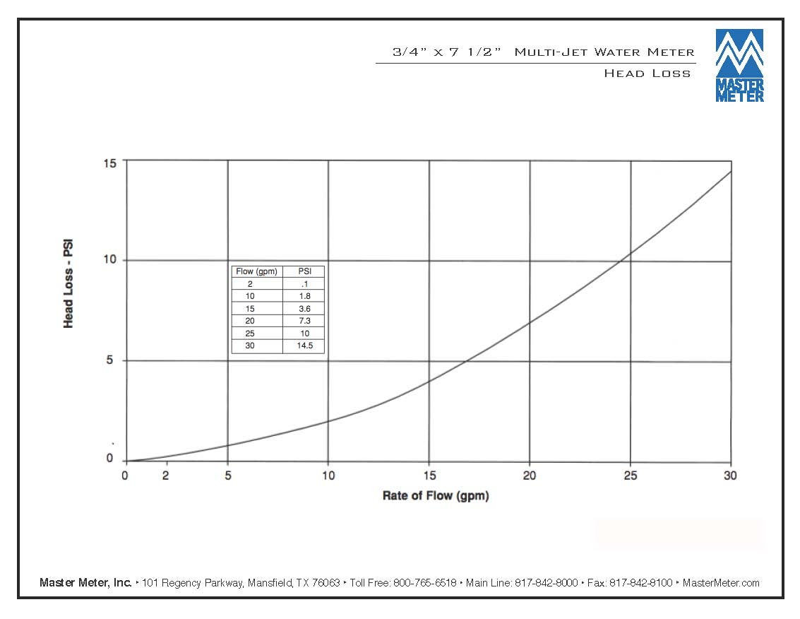
E

Slide 20
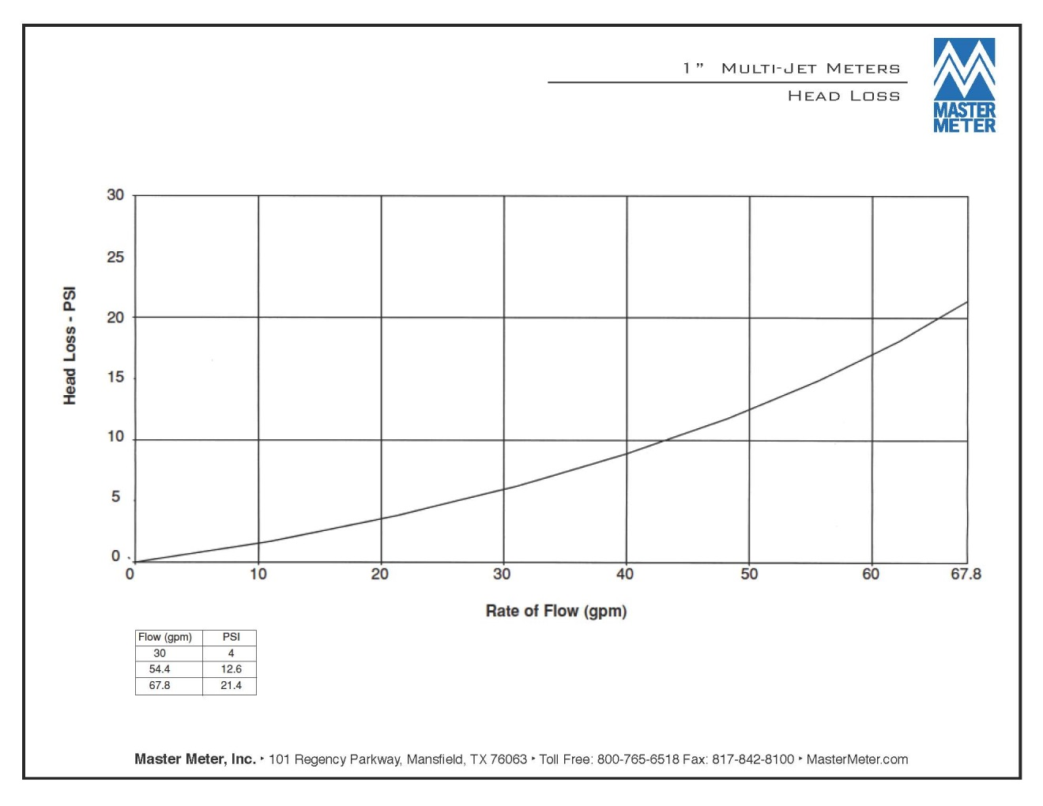
E

Slide 21
Questions

